Slide 1
Tripwire Alarm
Fauzan Lucky Alana Iskandar
Ibrahim Syah Qardhawi
Notes:
Verbatim dari word nya

Slide 2
Introduction
We propose a laser-based tripwire alarm
Demands: Promising market potential for homeowners and real estate manager
Needs: A reliable and responsive tripwire-alarm that is safe, easy to use, and can inform security personnel whenever any object passes through the tripwire
Justification: Tripwire-alarm is relatively cheap, and highly configurable

Slide 3
Objectives
Aim: To detect potential threat that passes through restricted area and alarm security personnel of said activity
Limitation: The tripwire itself does not prevent potential threat from accessing an area, only to detect and inform security personnel of said intrusion

Slide 4
Requirements
Safe
Accessible
Highly modular
Affordable

Slide 5
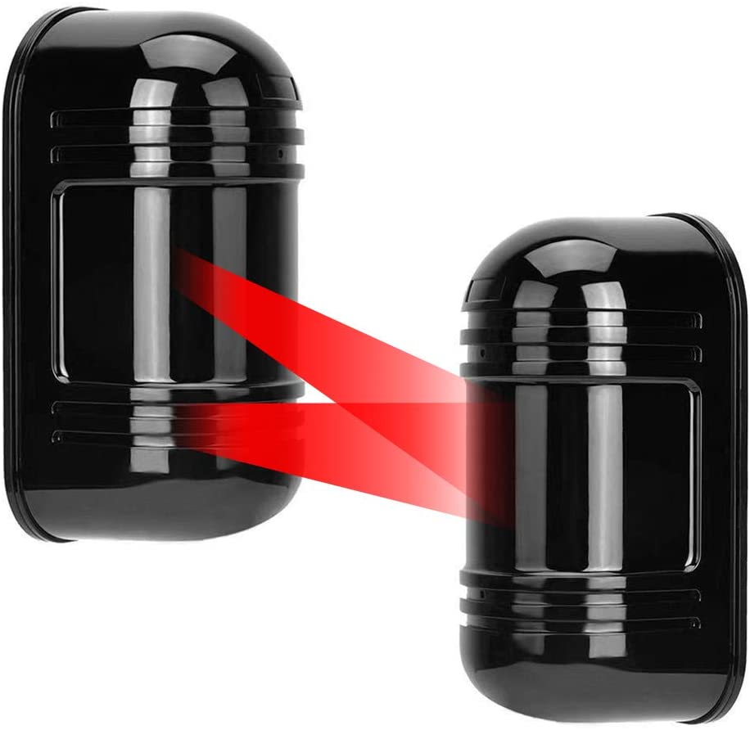
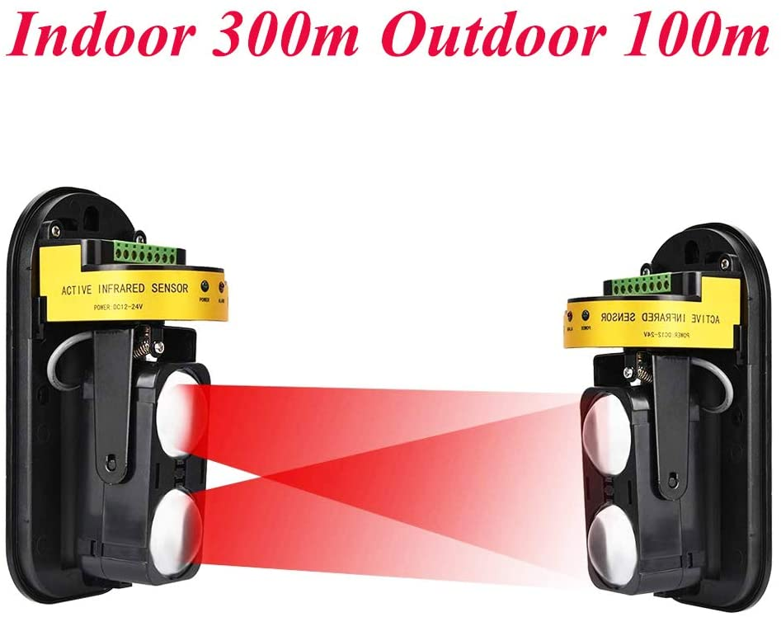
Literature Studies
Dahszhi Dual Laser Detector Alarm Beam Sensor
Notes:
Can’t find any technical detail online and don’t have the product on hand - but probably works the same
Big difference: uv filter(?) and lens to direct the laser

Slide 6
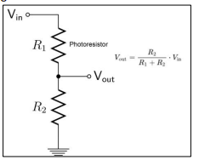
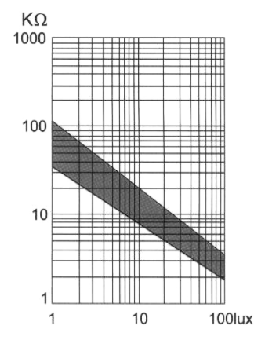

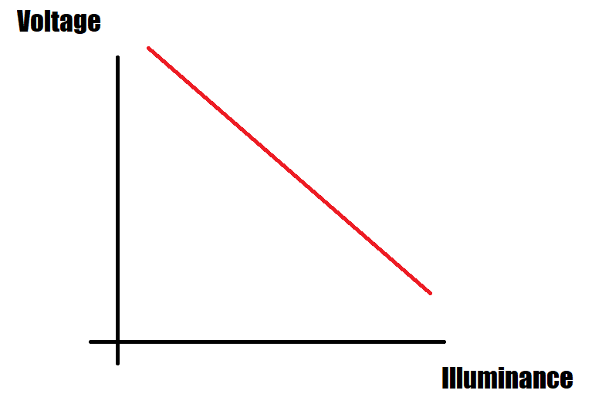
Literature Studies (cont’d)
Basic Theory
Notes:
On the left is the graph for the photoresistor from the data sheet (not exact): illuminance vs resistance
On the middle is a voltage divider circuit to get a voltage range using from the resistor. Below that is the roughly the relation of voltage and illuminance
On the right is an analog pin in arduino, which maps 0 - 5v input to 0 - 1024 integer in arduino

Slide 7
Methodology
These are the components we used for our model:
Arduino Uno
5V 650nm Laser diode
Photoresistor
Relay
2x Momentary switch/push button
RGB LED Common Cathode
Active piezoelectric speaker/buzzer
100Ω Resistor
3x 220Ω Resistor
330Ω Resistor
3x 10kΩ Resistor
Notes:
Main component: First 5 components
Following component: Resistors
Optional component: The rest

Slide 8
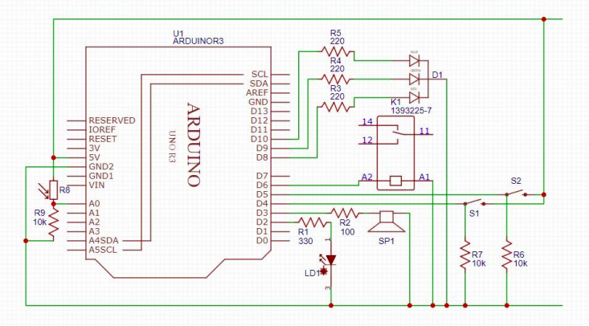
Design
Notes:
D2 - D6 are I/O
D8 - D10 are for RGB LED
A0 - is for the photoresistor

Slide 9
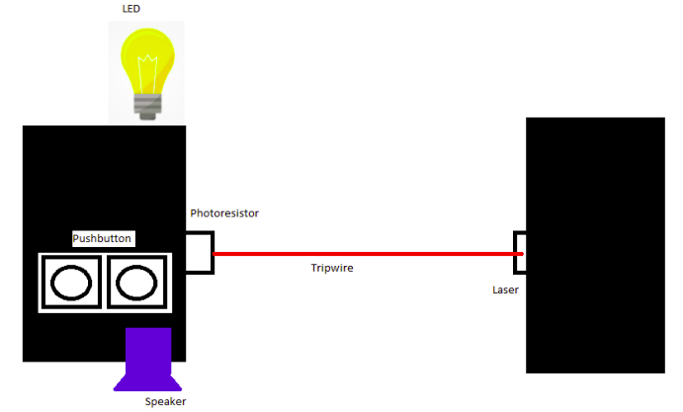
Design

Slide 10
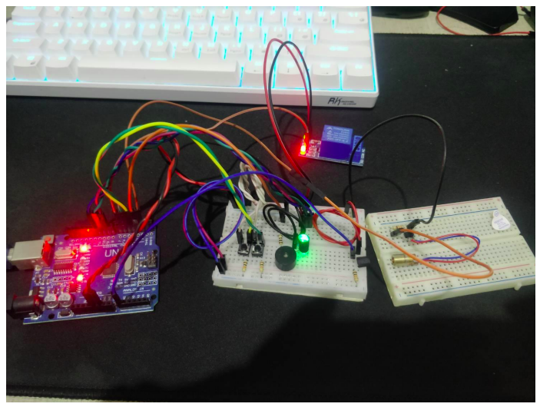

Slide 11
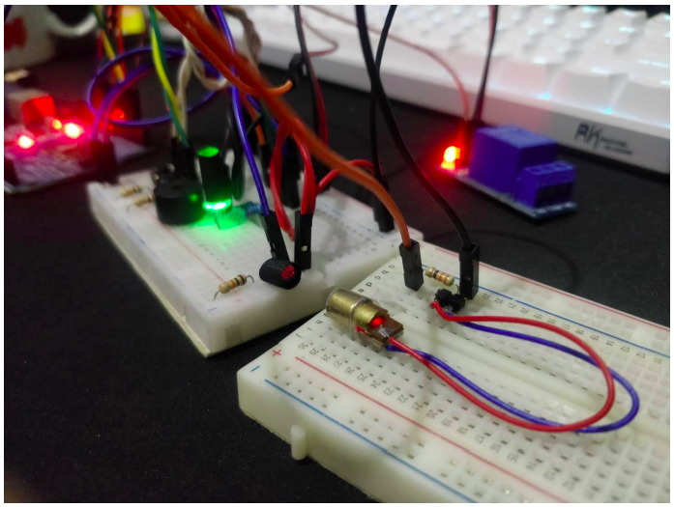

Slide 12
Conclusion

